Slide 2
The EAGLE Consortium
Sapienza, University of Rome Project Coordinator
Promoter Srl Technical Coordinator
University of Bari “Aldo Moro”
Heidelberg University
Oxford University
Univesity of Alcalà
Paris Lodron University Salzburg
Babeş-Bolyai University
Eötvös Loránd University
Juraj Dobrila University of Pula
Research Centre of the Slovenian Academy of Sciences and Arts Institute of Archaeology
Institut de recherche sur l’Antiquité et le Moyen-Age “Ausonius” UMR 5607 University of Bordeaux 3 CNRS
Katholieke Universiteit Leuven
Italian National Research Council CNR-ISTI
German Archeological Institute
The Cyprus Institute
Eureva
The British School at Rome
Gogate Srl

Slide 4
What is EAGLE?
Europeana network of Ancient Greek and Latin Epigraphy
EC Competitiveness and Innovation Programme (CIP – ICT PSP)
user-friendly portal for the vast majority of classical inscriptions

Slide 5
How to work with summaries
EAGLE characteristics
1.5 million items; 25 EU countries
state-of-the-art technology
mobile app for identification of inscriptions;
storytelling app for contextualisation
integration with Wikimedia and Europeana projects

Slide 7
➔

Slide 8
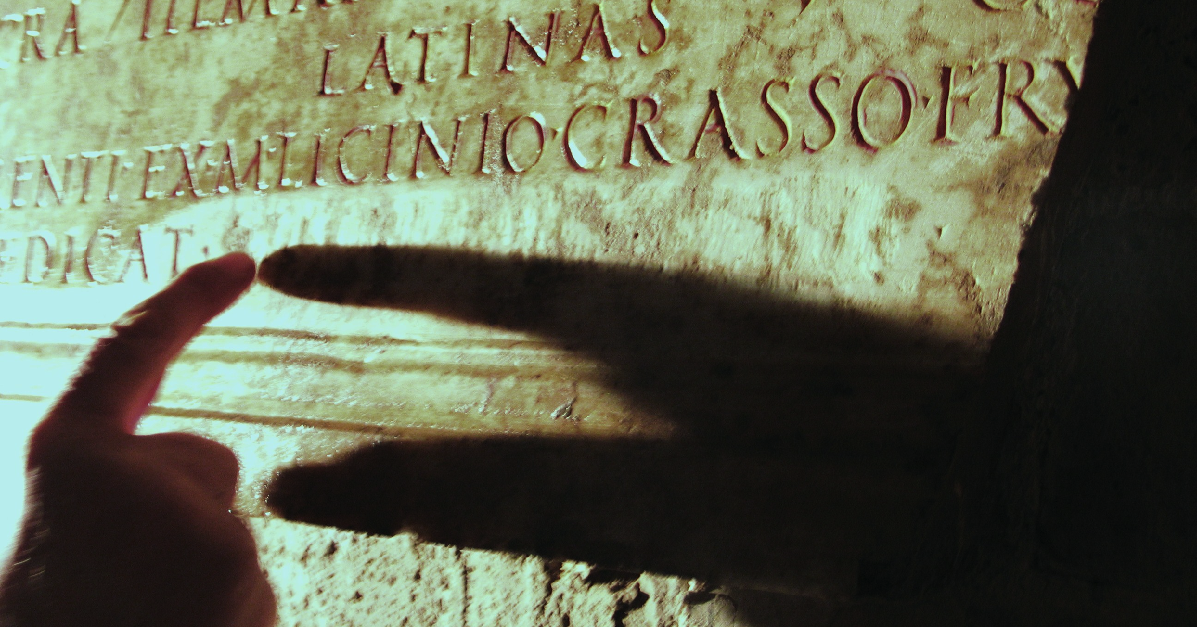
How to work with summaries
How to work with images
to establish a worldwide, free resource for Ancient Epigraphy linked to Europeana

Slide 9
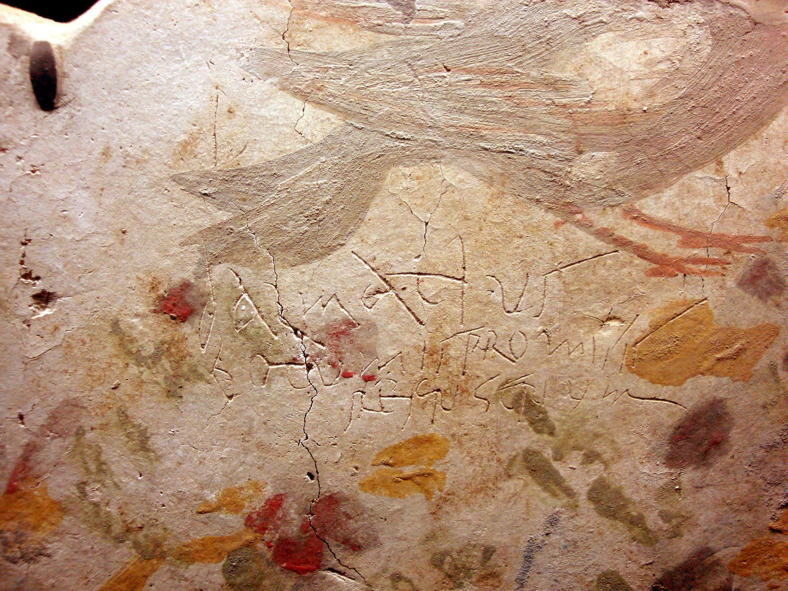
How to work with images and captions - 1
Rome, S. Sebastiano fuori-le-mura, memoria apostolorvm. Devotional graffito of Dalmativs in new Roman cursive
(ICVR, V 12932).
Second half of 3rd century.

Slide 10
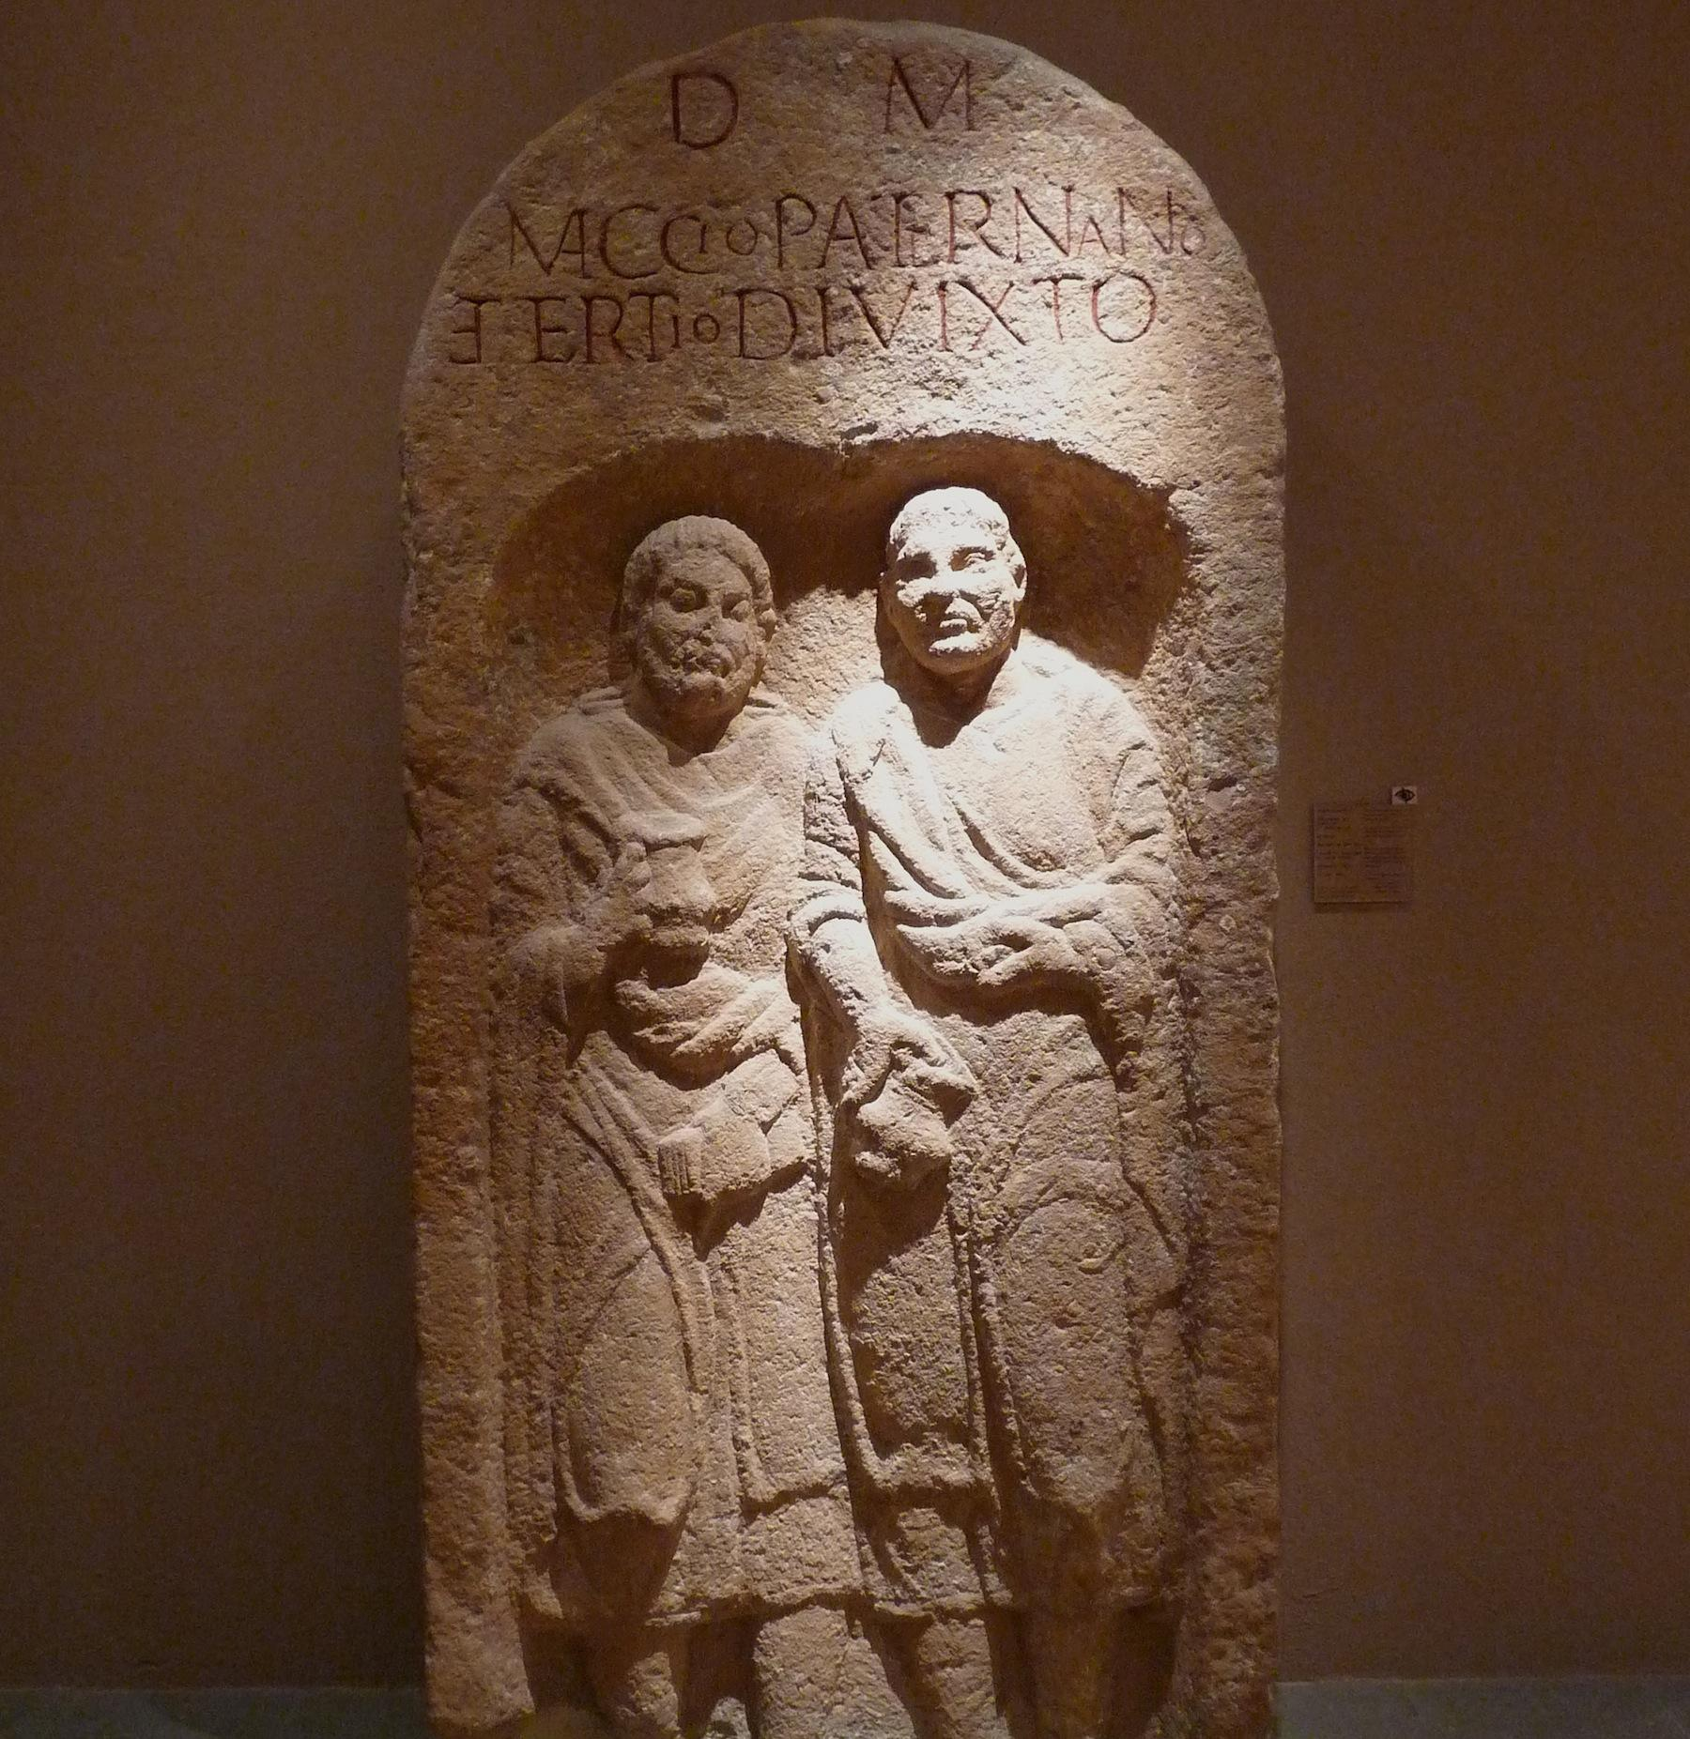
What is EAGLE?
How to work with images and captions - 2
Paternanus et Divixtus.
Epitaph.
Unterlinden Museum, Colmar, France.

Slide 11
➔

Slide 12
How to work with summaries
Basic Text
Summary (level 2)
summary (level 3)
summary (level 4)

Slide 13
?

Slide 14
Thank you!
Silvia Orlandi
silvia.orlandi@uniroma1.it Raffaella Santucci
raffaella.santucci@uniroma1.it

Slide 15
Replace text and adjust size
Replace text and adjust size
Replace text and adjust size
Toolbox

